Slide 1
Chronical Mental Illness: A Living Nightmare
PATRICIA L. PICKLES, Ph.D.
Notes:
Some find it difficult to have a conversation around chronic mental illness. In this short video I share research-based talking points that you may find useful.

Slide 2

Coming Out of the Mental Illness “Closet”
Our lives begin to end
The day we become silent
About things that matter.
Dr. Martin Luther King, Jr.
Notes:
SILENT

Slide 3

Children and Adolescents: The Facts about Mental Illness
Mental illness is the leading cause for hospitalization in children from 1-17
1 in 5 children will experience mental confusion
1 in 10 students will experience a serious emotional disorder
50% of students, aged 14 and older, drop out of school.
Suicide is the 3rd leading cause of death among 15–24-year-olds.
Notes:
1 in 5 children will experience mental confusion and 1 and 10 students will experience a serious emotional disorder. Suicide is the third leading cause of death among those 15-24 years old.

Slide 4
Higher Education and Mental Illness
75 percent of lifetime cases of mental health conditions begin by age 24.
One in four young adults between the ages of 18 and 24 have a diagnosable mental illness.
More than 11 percent of college students have been diagnosed or treated for anxiety in the past year and more than 10 percent reported being diagnosed or treated for depression.
.
Notes:
Most signs of chronic mental illness will emerge by or before the age of 24.

Slide 5
Higher Education: The Facts About Mental Illness
More than 80 percent of college students felt overwhelmed by and 45 percent have felt things were hopeless.
Almost 73 percent of students living with a mental health condition experienced a mental health crisis on campus. Yet, 34.2 percent reported that their college did not know about their crisis.
At least 50 percent of individuals with chronic mental illness abuse drugs or alcohol. The co-occurring disorders make it challenging to have a high quality of life.
Notes:
While away at school, if students experience a mental health crisis, how are family members informed of the episode? Is there a policy in place?

Slide 6

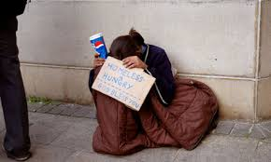
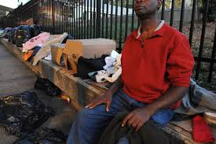
A Living Nightmare
Notes:
At least 50%, if not higher, of those suffering from chronic mental illness also suffer from a co-occurring disorder. The combination of both mental health issues and addiction can significantly impact, and be the demise of, one’s quality of life.

Slide 7
Disparities and Barriers to Mental Health Treatment
Fear
Indifference
No insurance, Lack of health insurance and barriers to Medicaid
Lack of professionals in the field
ADDITIONAL BARRIERS
Stereotypes
Stigma
Systemic Barriers
Notes:
For anyone who has been in search of quality mental health care, you are not alone. The experience is literally like living a daytime nightmare. Just as there was a math and science crisis in America, there is a huge mental health crisis.

Slide 8

Cultural Competence: the illness does not discriminate, only people do.
Notes:
The disease of mental illness itself does not discriminate – only people do…

